Slide 1
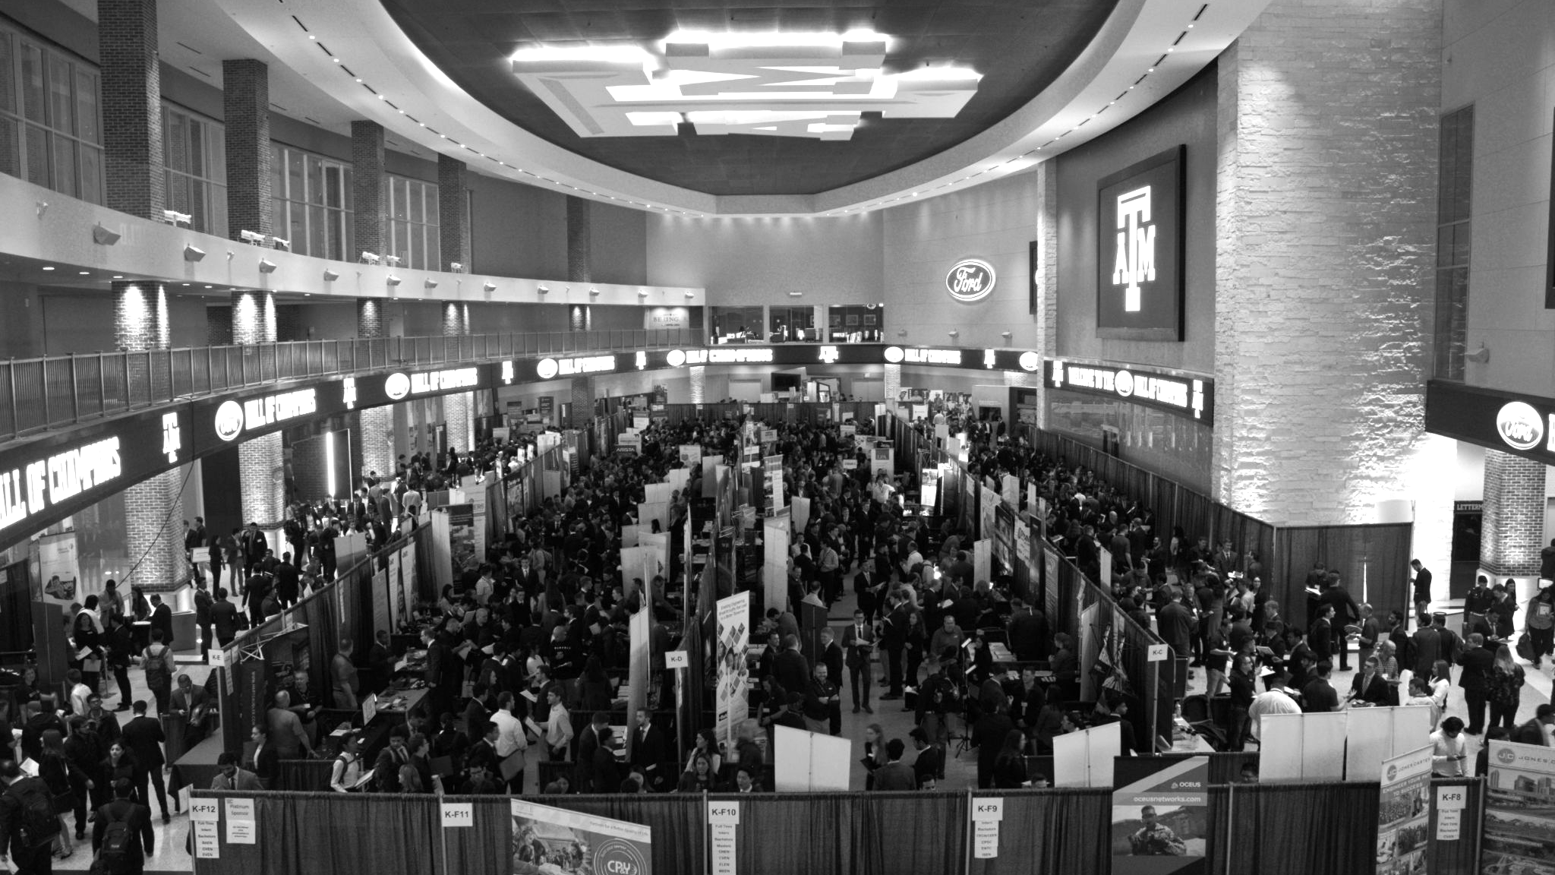

LANL Team Update
11/6/2024
Izzy Baumler, Dalton Boeckmann, Morgan Gullo, Jade Waldron

Slide 2
Mission Statement
There is a need for a technology that has 6 DOF and can move through its full range of motion in each degree of freedom up to 1 Hz.

Slide 3
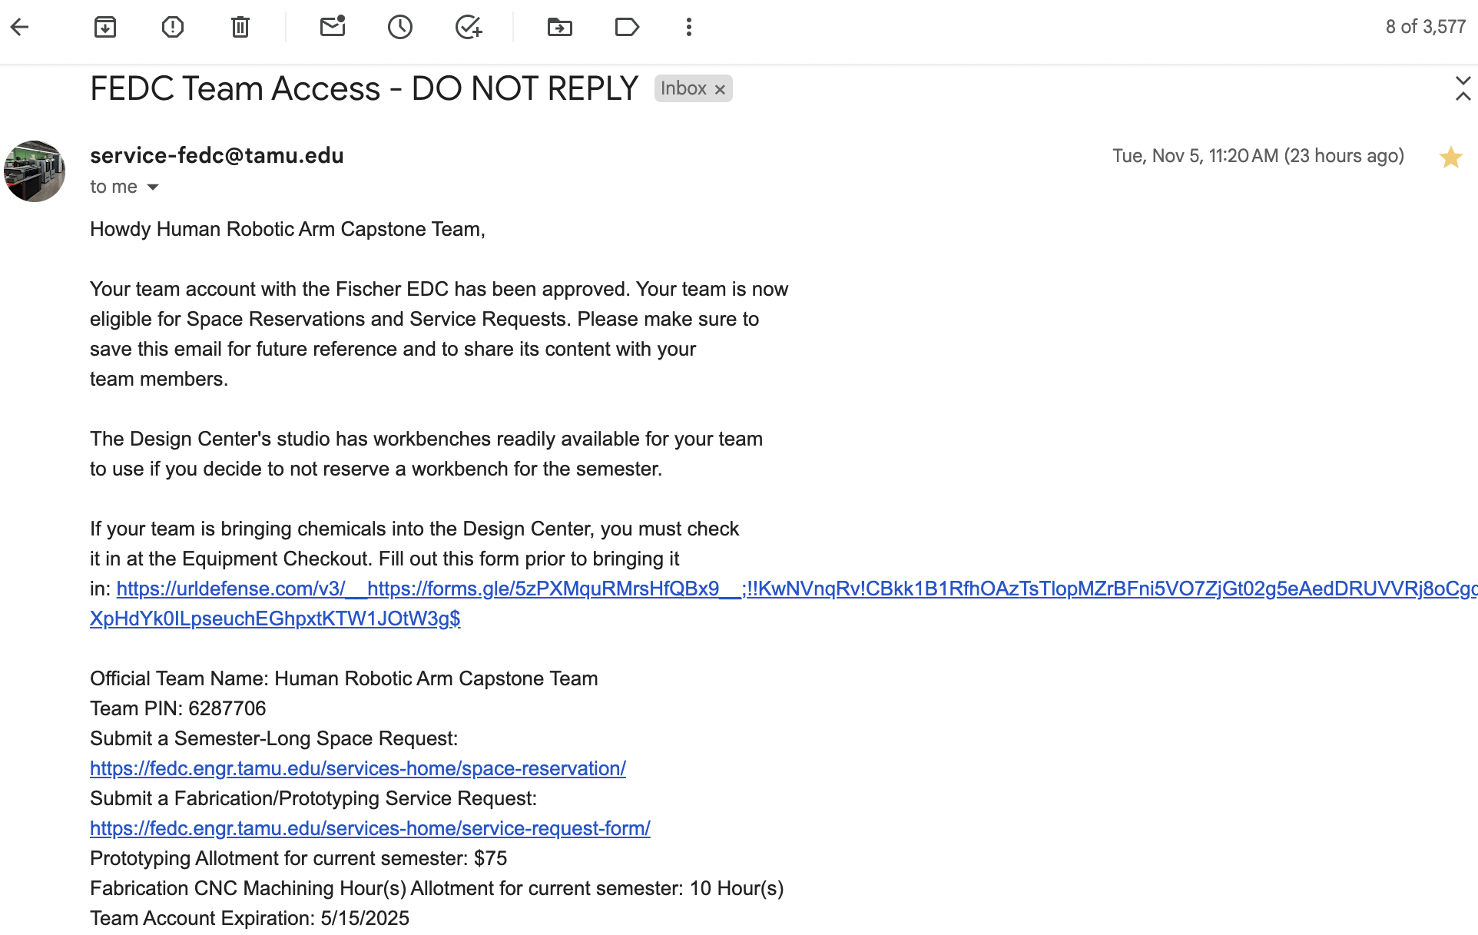
Weekly Updates
Started the process of reserving a space for the FEDC and began Red Badge Training
Jade already has Red Badge access, Dalton and Morgan have training tomorrow and Izzy is scheduling hers
Received a team pin and waiting for a response from the FEDC to confirm a space

Slide 4
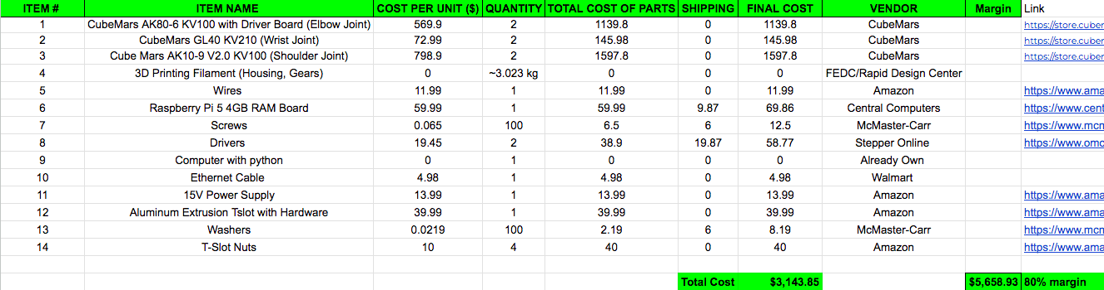
Preliminary Bill of Materials

Slide 5
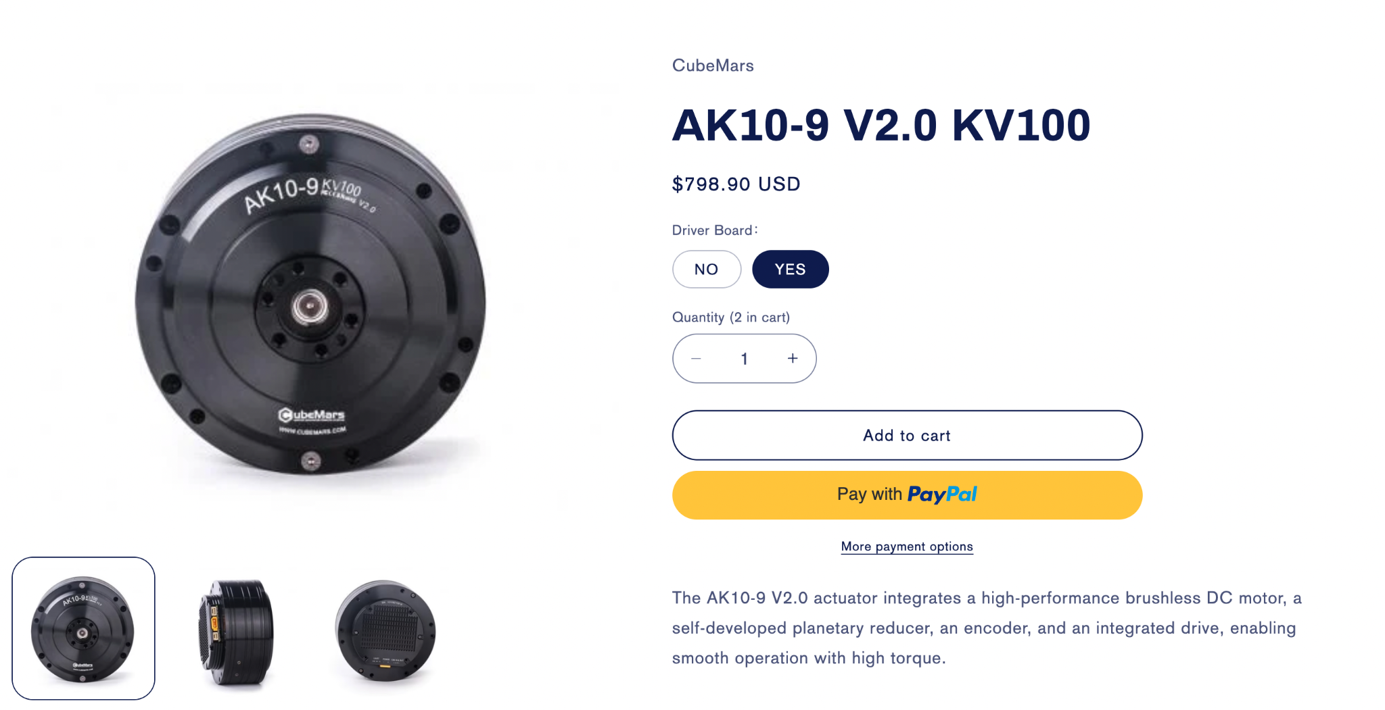
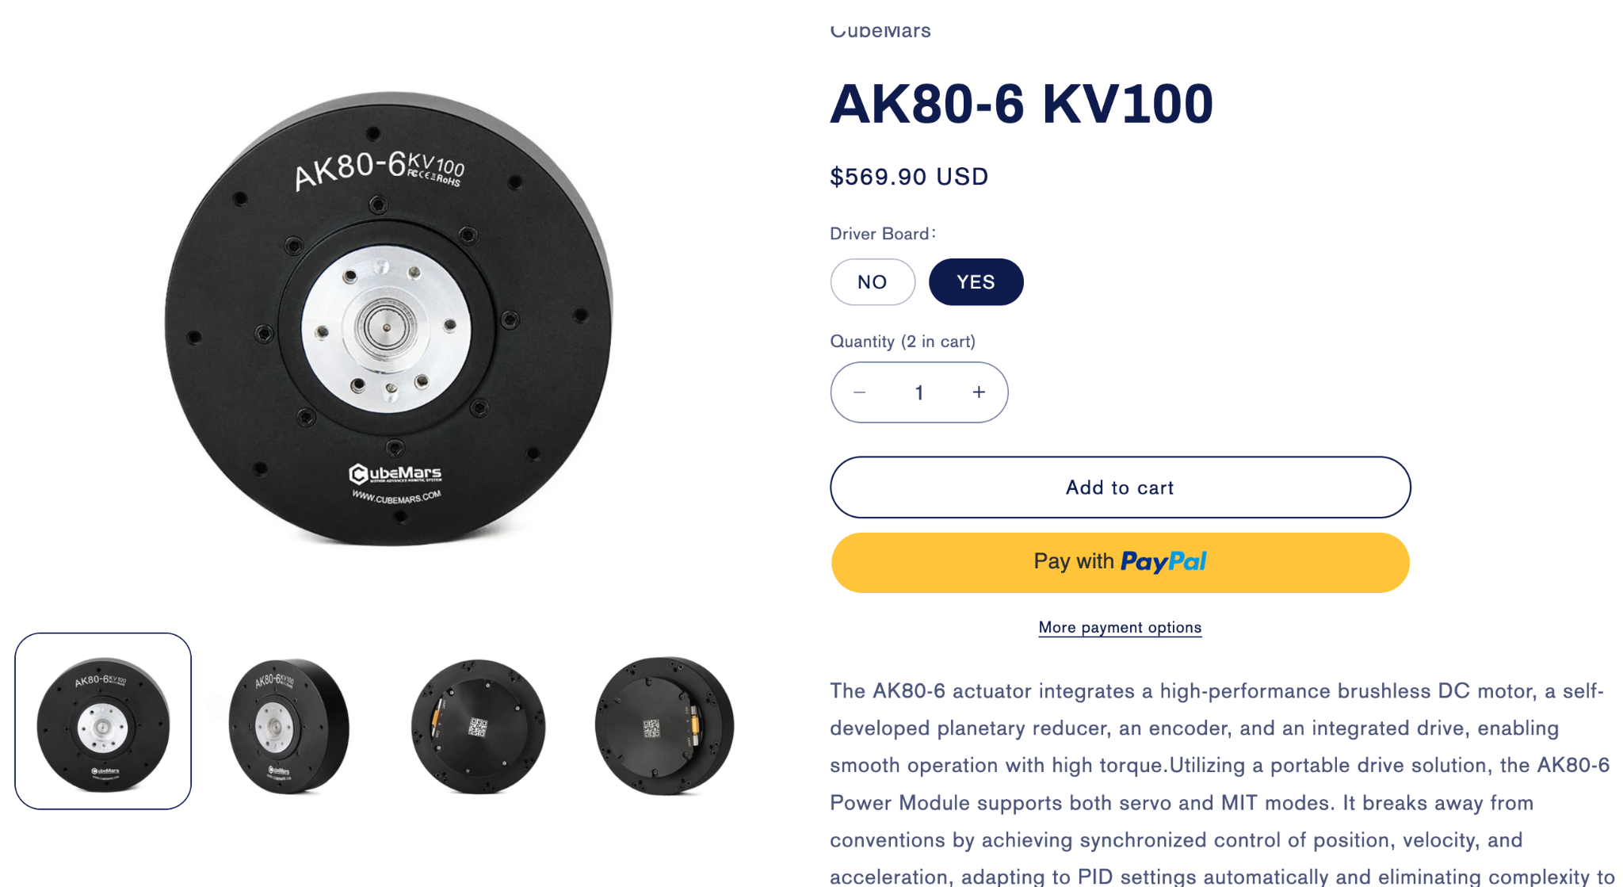
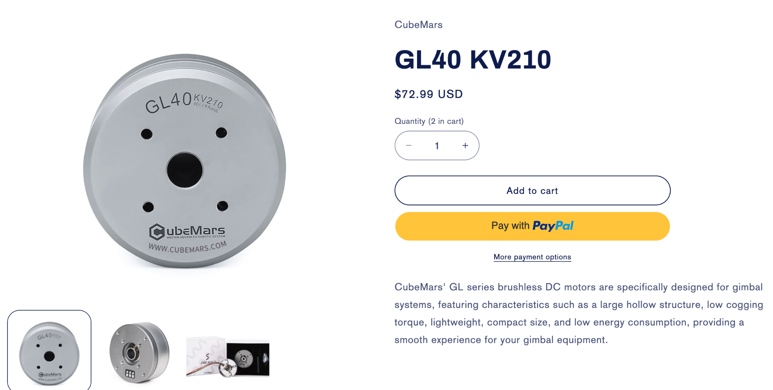
Preliminary Bill of Materials
Shoulder Joint
Elbow Joint
Wrist Joint

Slide 6
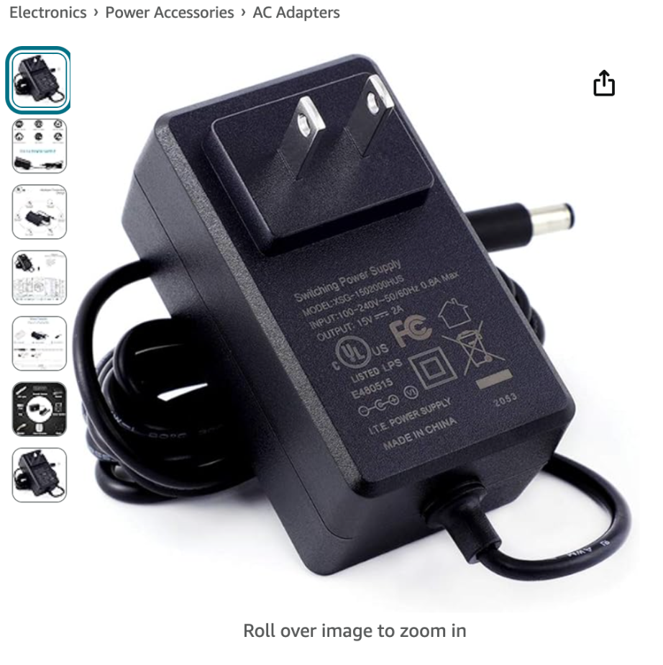
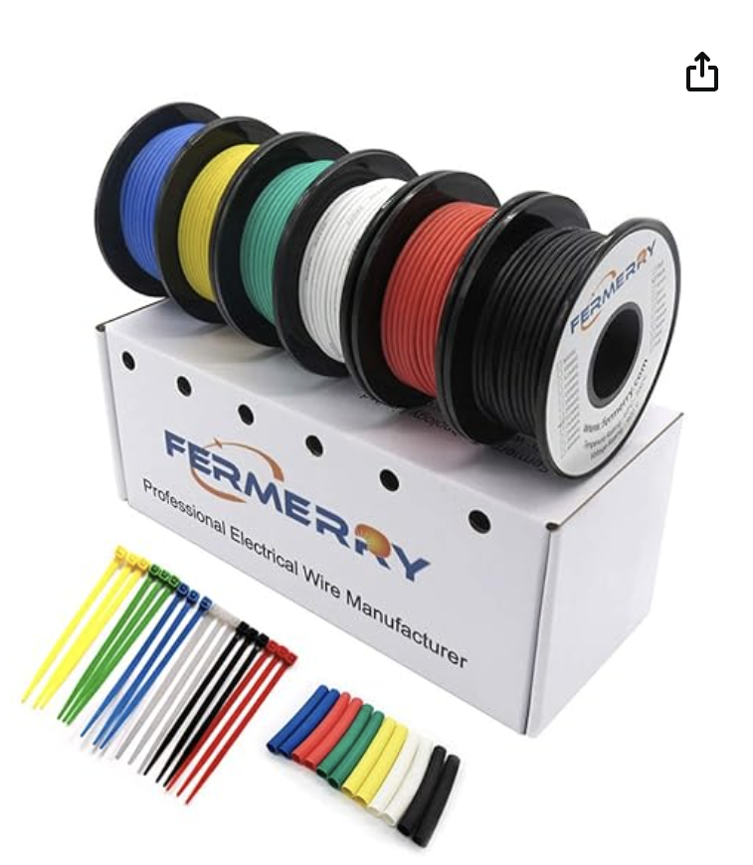
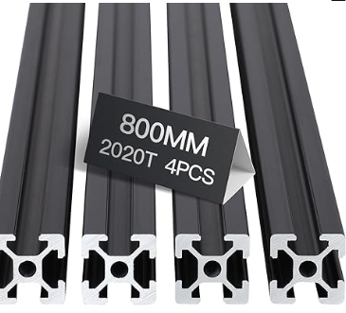
Preliminary Bill of Materials

Slide 7
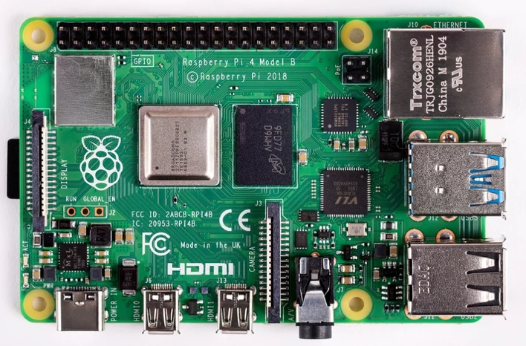
Preliminary Bill of Materials

Slide 8
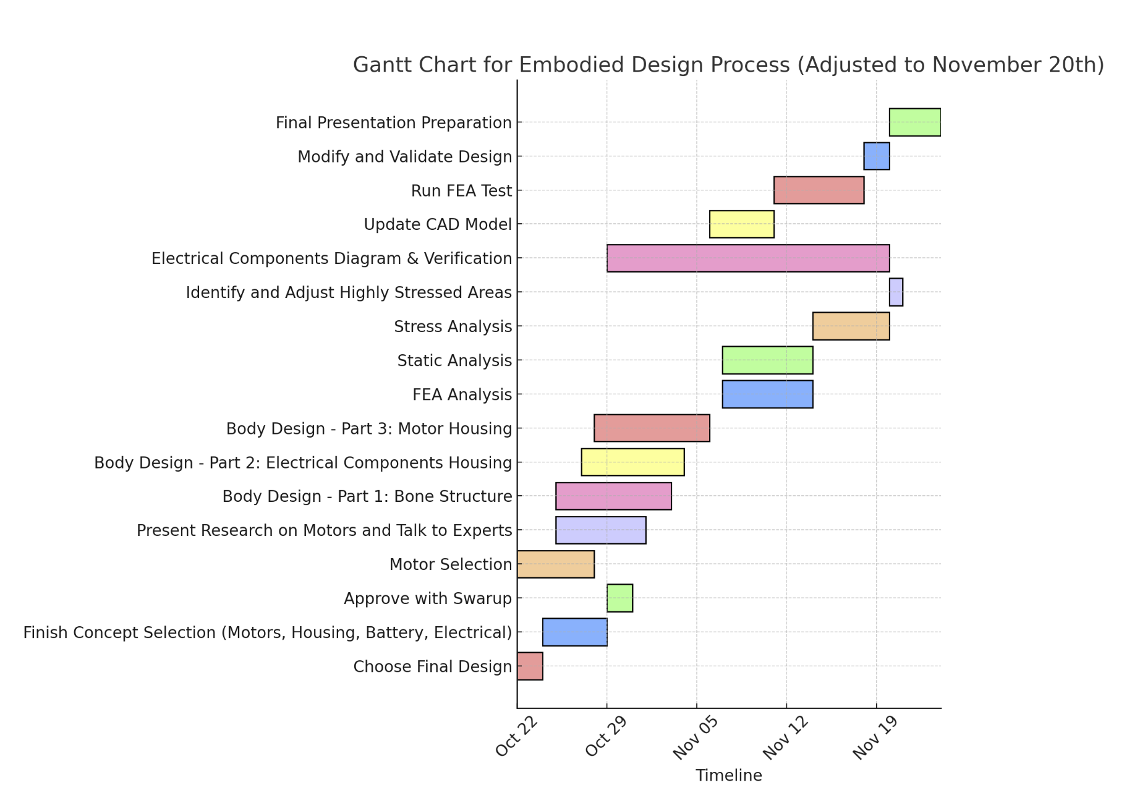
Planning for Embodiment Design Process
Organized a detailed Gantt chart for the embodiment design process, once we choose a final design
Planning to closely follow this schedule to ensure things are finished and validated

Slide 9
Validation Plan - Brainstorming
The team began brainstorming ideas for the Validation Plan that we are going to execute in MEEN 402:
Finite Element Analysis (FEA) to see the amount of payload the arm can support without straining or seizing the motors
Inspect all joints to ensure they are free from any obstructing components
Implement initial codes for small translational/rotational movements to validate the motor inputs correspond with the output performance
Validate each motor one at a time before trying to perform movements with multiple at once
Verify each joint speed to confirm the achieved frequency
Calculate the total arm weight and confirm with scale measurement

Slide 10
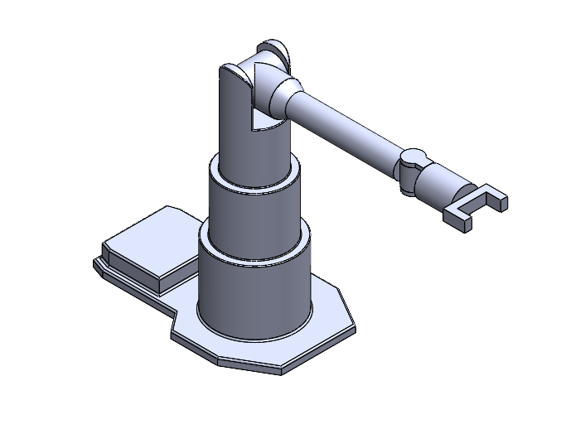
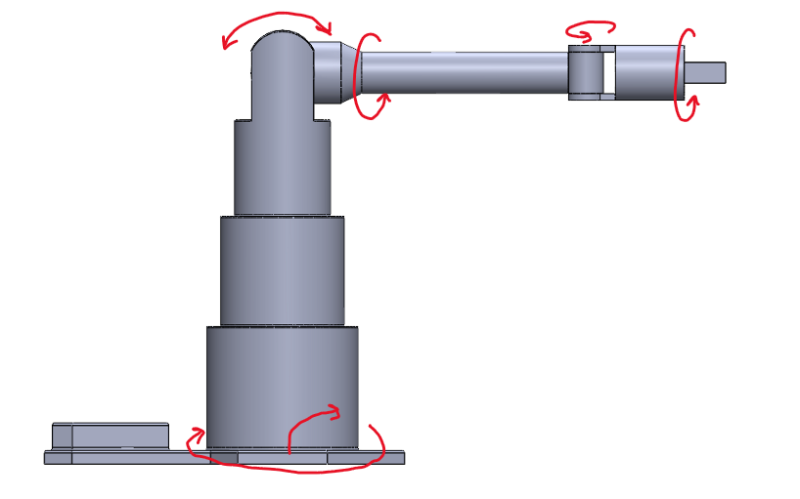
Concept

Slide 11
Upcoming Week
Start Detailed CAD Model
Continue working on Embodiment Design
Continue Validation planning
Begin looking at DR3 content

